Slide 1
Introduction to Data Science

Slide 2
Quotes and Surveys on Data Science
McKinsey Study forecasted: 10 Times More Managers per Data Savvy Person
HBR Hype: “The Sexiest Job of the 21st Century”
“By 2018, the US could face a shortage of up to 190,000 workers with analytical skills” McKinsey Global Institute
A data scientist is someone who knows more statistics than a computer scientist and more computer science than a statistician.
Data Scientist = statistician + programmer + DBA + coach + storyteller + artist

Slide 3
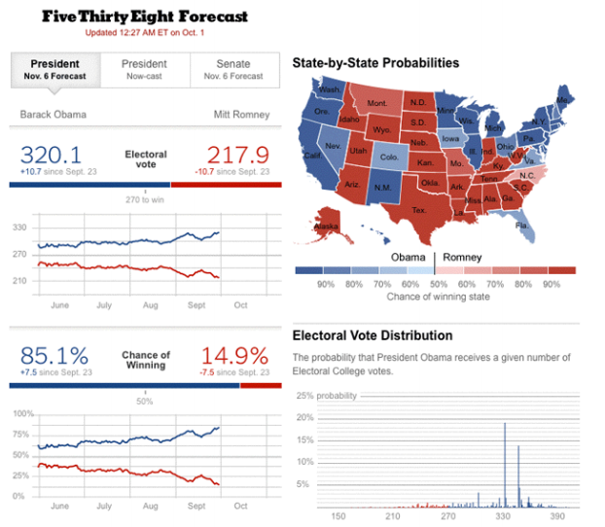
“Nate Silver won the election” – HBR

Slide 4
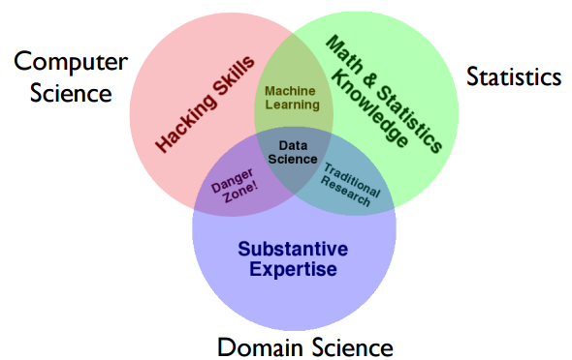
Data Science

Slide 5
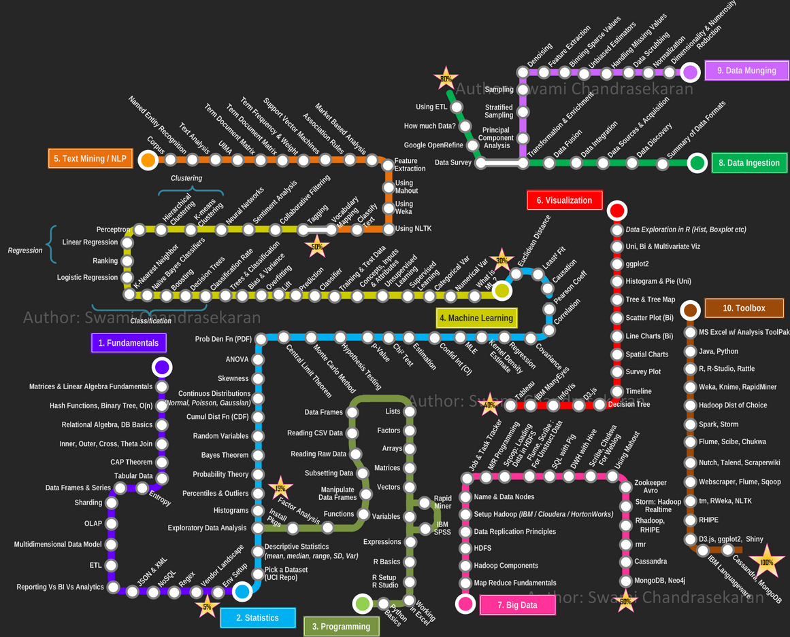

Slide 6
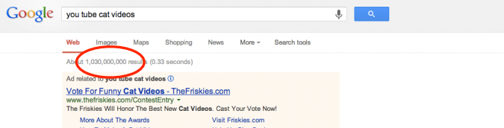
Big Data
“Between the dawn of civilization and 2003, we only created five exabytes of information; now we’re creating that amount every two days.” Eric Schmidt, Google (and others)

Slide 7
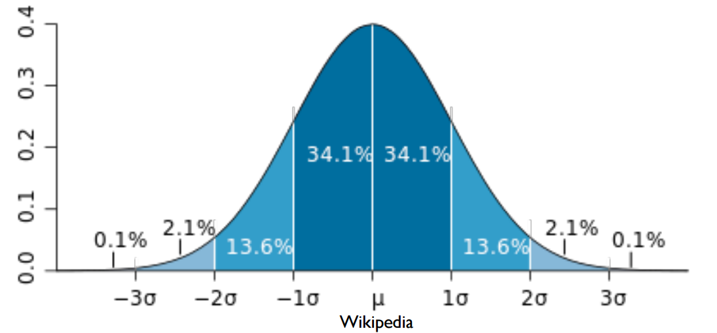
Normal (Gaussian) Distribution
symmetry
central limit theorem
68-95-99.7% rule

Slide 8
Decision Trees Step by Step

Slide 9
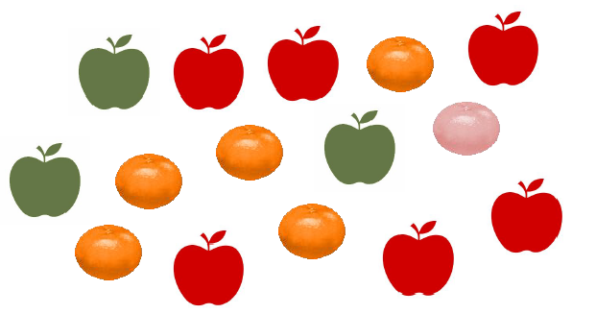
Split Apples & Mandarins

Slide 10
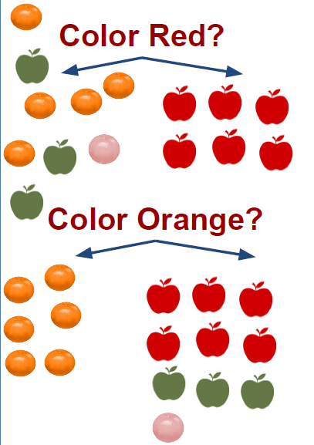
What Are The Features That Describe The Target?
Feature is an individual measurable property of a phenomenon being observed. The variable with the most important information about the target variable.
Which variable can split the group as homogeneous with respect to the target variable? (pure vs. impure)
• Weight: light, medium, heavy - or x gram
• Size: round or not
• Color: green, orange, red
• Surface: flat or porous surface

Slide 11
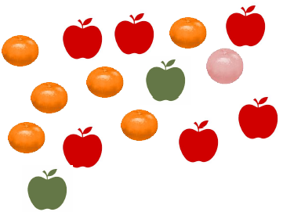
ENTROPY & Information Gain
Entropy is a measure of disorder. Entropy only tells us how impure one individual subset is.
Information Gain measures how much a given feature improves (decreases) entropy over the whole segmentation it creates.
Select feature with:
Highest Entropy Reduction
Highest Information Gain
Entropy = -p1 * log (p1) - p2 * log (p2)
INFORMATION GAIN = Entropy (Before) - Entropy (After)
Apple: p(apple)= 8/15
Mandarines: p(mandarine)= 7/15
ENTROPY (Without Split):
-p(apple)*log(p(apple)) -(mandarins)*log(p(mandarines))
= 0.996791632 = 1

Slide 12
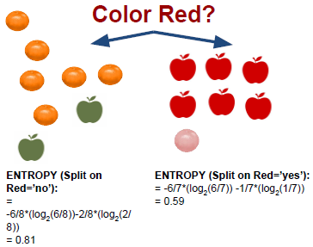
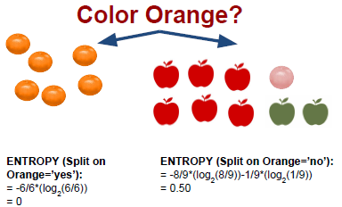
Calculate entropy and Info Gain
Entropy =-p1 * log (p1) - p2 * log (p2)
ENTROPY (After Split on Red):
= 8/15* ENTROPY (Split on Red=’no’) + 7/15* ENTROPY (Split on Red=’yes’)
= 0.43 + 0.28 = 0.71
INFORMATION GAIN
= Entropy (Before) - Entropy (After) = 1 - 0.71 = 0.29
ENTROPY (After Split on Orange):
= 6/15* ENTROPY (Split on Orange=’no’)
+ 9/15* ENTROPY (Split on Orange=’yes’)
= 0 + 0.23 = 0.23
INFORMATION GAIN
= Entropy (Before) - Entropy (After) = 1 - 0.23 = 0.77

Slide 13
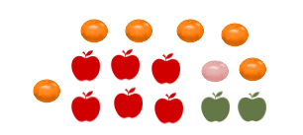
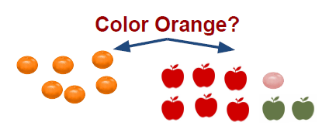
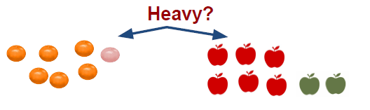
Which Feature Would Be Better to split?
Always Start With Highest IG

Slide 14
Model Training and Test

Slide 15
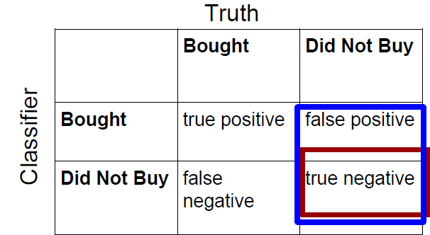
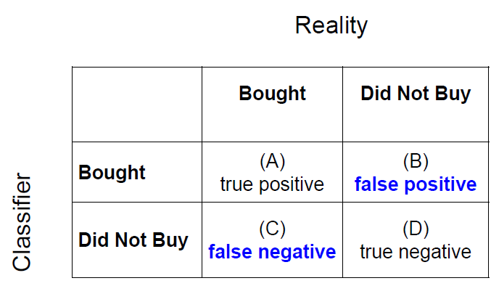
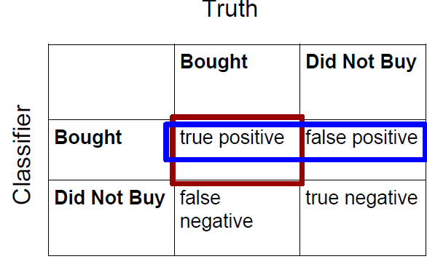
CONFUSION MATRIX
TRUE NEGATIVE = # of true negative / truth
PRECISION= # of true positives / Total in this
prediction class

Slide 16
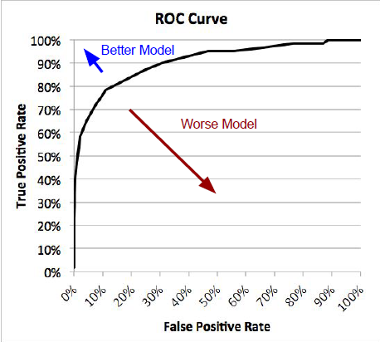
ROC CURVE

Slide 17
How Can I Improve the Quality?

Slide 18
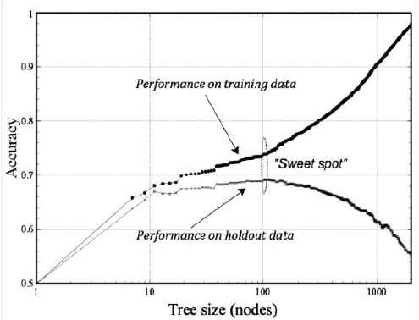
Overfitting the model
The More Nodes - The
More Likely To Overfit

Slide 19
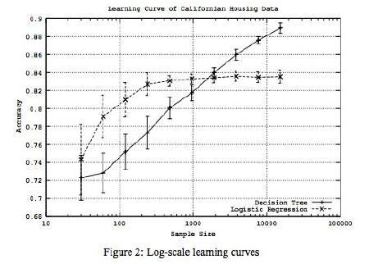
Decision Tree Vs Logistic Regression
Decision Trees are good in identifying LOCAL patterns, but they often need more data.

Slide 20
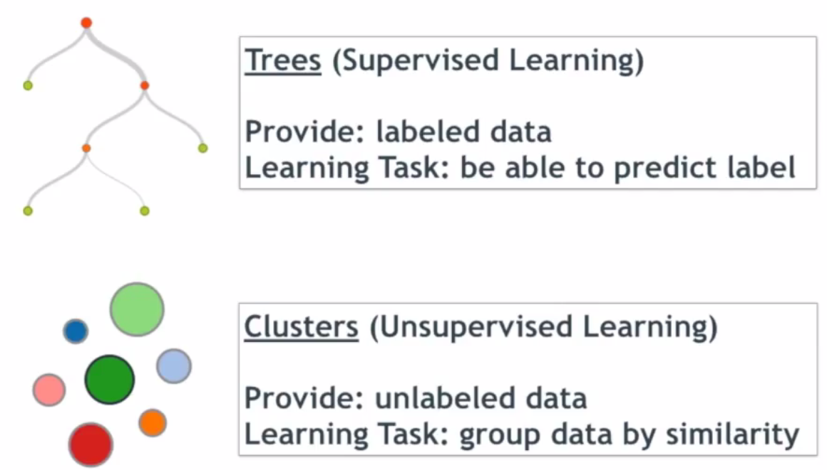
Trees Vs Cluster

Slide 21
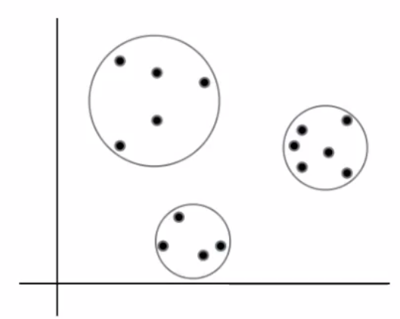
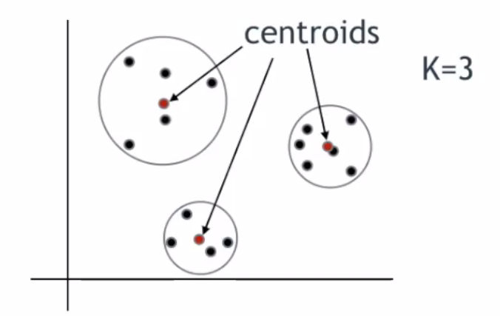
Clustering basics

Slide 22
Big Data

Slide 23
How Was Big Data Infrastructure Invented?

Slide 24
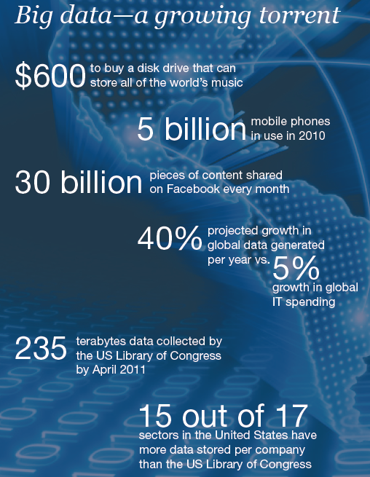
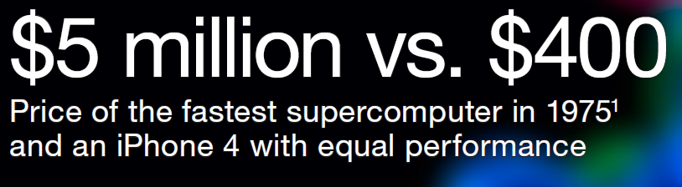

Slide 25
Motivation: Google Example
20+ billion web pages x 20KB = 400+ TB
1 computer reads 30-35 MB/sec from disk
~4 months to read the web
~1,000 hard drives to store the web
Takes even more to do something useful with the data!
Today, a standard architecture for such problems is emerging:
Cluster of commodity Linux nodes
Commodity network (ethernet) to connect them

Slide 26
Cluster Architecture
2-10 Gbps backbone between racks
1 Gbps between
any pair of nodes
in a rack
Switch
Switch
Switch
CPU
CPU
CPU
CPU
Mem
…
Mem
Mem
…
Mem
Disk
Disk
Disk
Disk
Each rack contains 16-64 nodes
In 2011 it was guestimated that Google had 1M machines, http://bit.ly/Shh0RO

Slide 27
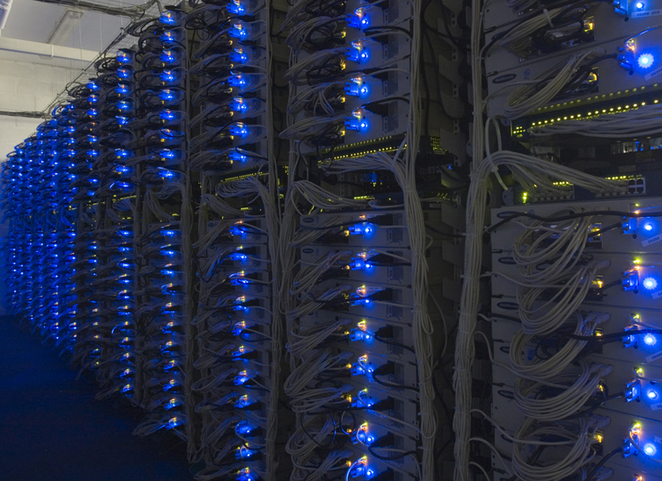

Slide 28
Large-scale Computing
Large-scale computing for data mining problems on commodity hardware
Challenges:
How do you distribute computation?
How can we make it easy to write distributed programs?
Machines fail:
One server may stay up 3 years (1,000 days)
If you have 1,000 servers, expect to loose 1/day
People estimated Google had ~1M machines in 2011
1,000 machines fail every day!

Slide 29
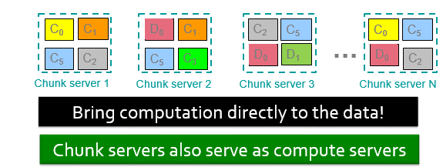
Distributed File System
Chunk servers
File is split into contiguous chunks
Typically each chunk is 16-64MB
Each chunk replicated (usually 2x or 3x)
Try to keep replicas in different racks
Master node
a.k.a. Name Node in Hadoop’s HDFS
Stores metadata about where files are stored
Might be replicated
Client library for file access
Talks to master to find chunk servers
Connects directly to chunk servers to access data
Reliable distributed file system
Data kept in “chunks” spread across machines
Each chunk replicated on different machines
Seamless recovery from disk or machine failure

Slide 30
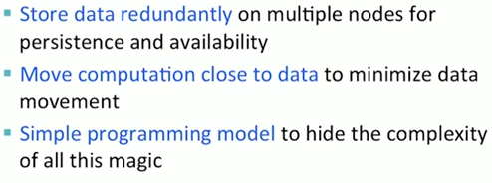
MAP reduce

Slide 31
MapReduce: Word Counting
Provided by the programmer
Provided by the programmer
MAP:
Read input and produces a set of key-value pairs
Group by key:
Collect all pairs with same key
Reduce:
Collect all values belonging to the key and output
The crew of the space shuttle Endeavor recently returned to Earth as ambassadors, harbingers of a new era of space exploration. Scientists at NASA are saying that the recent assembly of the Dextre bot is the first step in a long-term space-based man/mache partnership. '"The work we're doing now -- the robotics we're doing -- is what we're going to need ……………………..
(The, 1)
(crew, 1)
(of, 1)
(the, 1)
(space, 1)
(shuttle, 1)
(Endeavor, 1)
(recently, 1)
….
(crew, 1)
(crew, 1)
(space, 1)
(the, 1)
(the, 1)
(the, 1)
(shuttle, 1)
(recently, 1)
…
(crew, 2)
(space, 1)
(the, 3)
(shuttle, 1)
(recently, 1)
…
Sequentially read the data
Only sequential reads
Big document
(key, value)
(key, value)
(key, value)

Slide 32
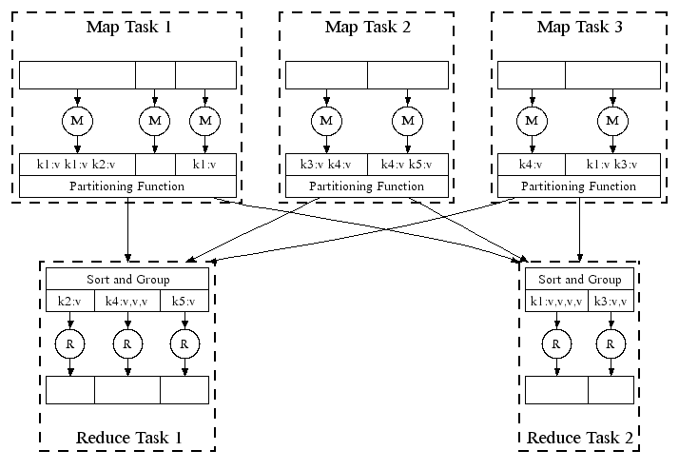
Map-Reduce: In Parallel
All phases are distributed with many tasks doing the work

Slide 33
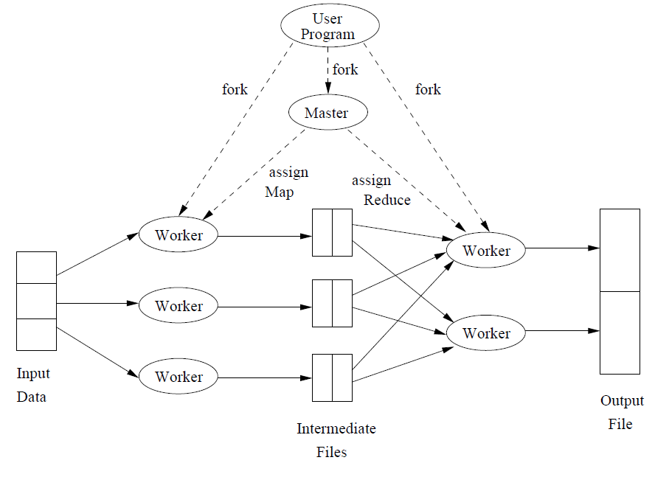
Overview of the execution of a MapReduce program
MapReduce is not a solution to every problem, not even every problem that
profitably can use many compute nodes operating in parallel. The entire distributed-file-system milieu makes sense only when
files are very large and are rarely updated in place.

Slide 34
PageRank: The “Flow” Formulation

Slide 35
Links as Votes
Idea: Links as votes
Page is more important if it has more links
In-coming links? Out-going links?
Think of in-links as votes:
www.stanford.edu has 23,400 in-links
www.joe-schmoe.com has 1 in-link
Are all in-links are equal?
Links from important pages count more
Recursive question!

Slide 36
Example: PageRank Scores
B
38.4
C
34.3
A
3.3
D
3.9
E
8.1
F
3.9
1.6
1.6
1.6
1.6
1.6

Slide 37
Simple Recursive Formulation
Each link’s vote is proportional to the importance of its source page
If page j with importance r_{j} has n out-links, each link gets r_{j} / n votes
Page j’s own importance is the sum of the votes on its in-links
i
k
r_{i}/3
r_{k}/4
j
r_{j}/3
r_{j} = r_{i}/3+r_{k}/4
r_{j}/3
r_{j}/3

Slide 38

PageRank: The “Flow” Model
A “vote” from an important page is worth more
A page is important if it is pointed to by other important pages
Define a “rank” r_{j} for page j
The web in 1839
y/2
y
a/2
y/2
m
a
m
a/2
“Flow” equations:
r_{y} = r_{y} /2 + r_{a} /2
r_{a} = r_{y} /2 + r_{m}
r_{m} = r_{a} /2
$d_{i}$ … out-degree of node $i$

Slide 39
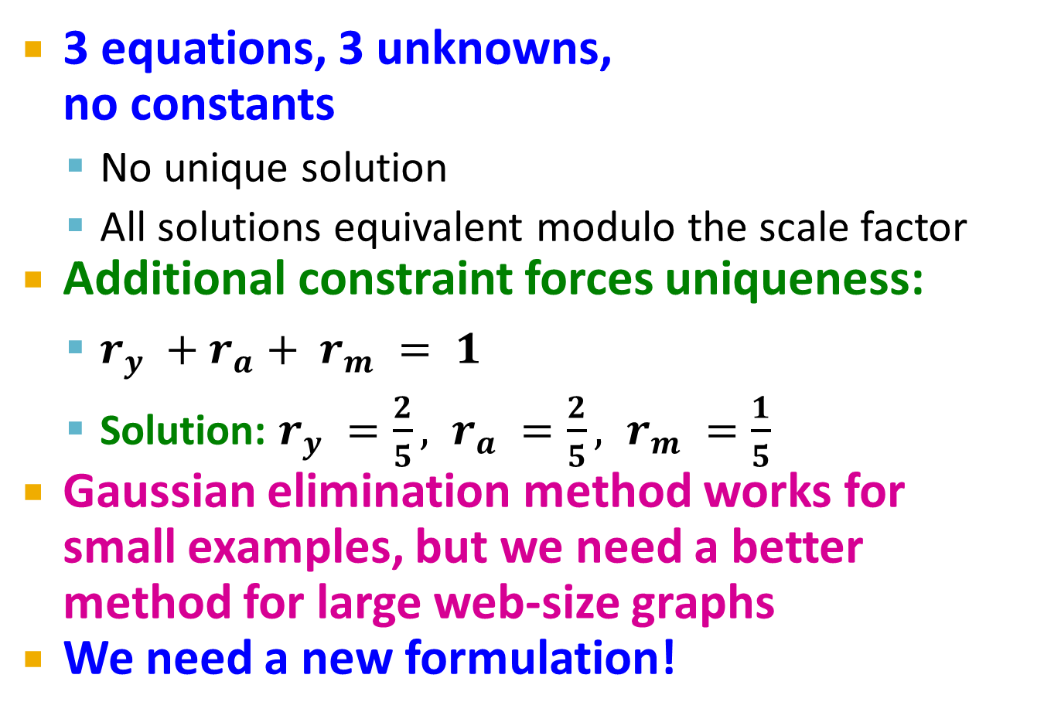
Solving the Flow Equations
Flow equations:
3 equations, 3 unknowns, no constants
No unique solution
All solutions equivalent modulo the scale factor
Additional constraint forces uniqueness:
$r_{y} +r_{a}+ r_{m} = 1$
Solution: $r_{y} =\frac{2}{5}, r_{a} =\frac{2}{5}, r_{m} =\frac{1}{5}$
Gaussian elimination method works for small examples, but we need a better method for large web-size graphs
We need a new formulation!
r_{y} = r_{y} /2 + r_{a} /2
r_{a} = r_{y} /2 + r_{m}
r_{m} = r_{a} /2

Slide 40
Face Detection using Haar Cascades

Slide 41
It is a machine learning based approach where a cascade function is trained from a lot of positive and negative images. It is then used to detect objects in other images.
Here we will work with face detection. Initially, the algorithm needs a lot of positive images (images of faces) and negative images (images without faces) to train the classifier. Then we need to extract features from it. For this, haar features shown in below image are used. They are just like our convolutional kernel. Each feature is a single value obtained by subtracting sum of pixels under white rectangle from sum of pixels under black rectangle.

